Slide 1
Software Architecture
Module 5
Architecture Reconstruction
Harvinder S Jabbal
SEZG651/SSZG653 Software Architectures

Slide 2
Contents
Purpose of architecture reconstruction
Architecture reconstruction technique
Reconstruction tools.
March 2, 2024
SEZG651/SSZG653 Software Architectures

Slide 3
Purpose of architecture reconstruction
To understand the architecture of a system for which no documentation exists
To migrate a system from old technology to new. Ex. Mainframe to Web
To identify reusable components in a system, such as logging component, security component, etc.
March 2, 2024
SEZG651/SSZG653 Software Architectures

Slide 4
Phases of architecture reconstruction
Identify components and their relationship (using a tool)
Aggregate components into abstract components (specify grouping to tool)
Analyse the architecture (tool displays architecture)
March 2, 2024
SEZG651/SSZG653 Software Architectures

Slide 5
Identify components & their relationship
Extract information from
  Source code
  Execution traces
  Build scripts
  Etc.
This gets info such as
  classes
  file they use
  ‘Caller – callee’ relationship
  global data accessed by different objects
March 2, 2024
SEZG651/SSZG653 Software Architectures

Slide 6
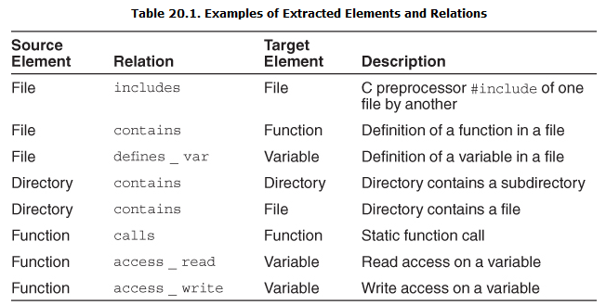
Examples of component extraction
Ref: Text book: Software Arch in practice by Len Bass and others
March 2, 2024
SEZG651/SSZG653 Software Architectures

Slide 7
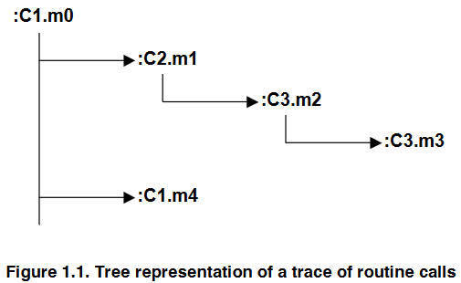
Execution trace of method calls
Ref: Techniques to Simplify the Analysis of Execution Traces for Program Comprehension by Abdelwahab Hamou-Lhadj
https://pdfs.semanticscholar.org/3db0/dd1980586c0a9d489e4b94c2996f117df2d5.pdf
March 2, 2024
SEZG651/SSZG653 Software Architectures

Slide 8
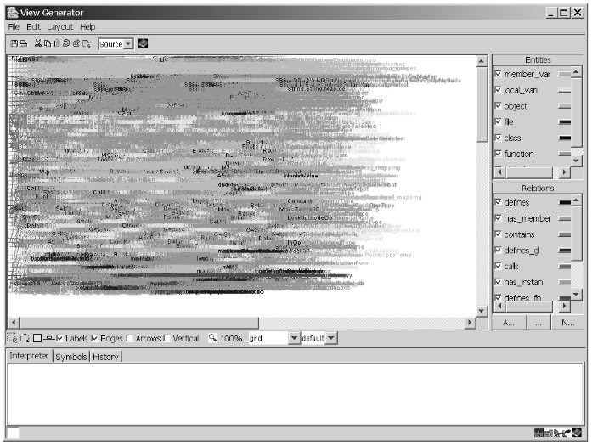
Case study: ‘Vanish’ System
Tool used for reconstruction: ARMIN
(ARchitecture Reconstruction and MINing)
White-Noise” View Showing All of the Elements and Relations
March 2, 2024
SEZG651/SSZG653 Software Architectures
Ref: https://resources.sei.cmu.edu/asset_files/TechnicalNote/2003_004_001_14141.pdf

Slide 9
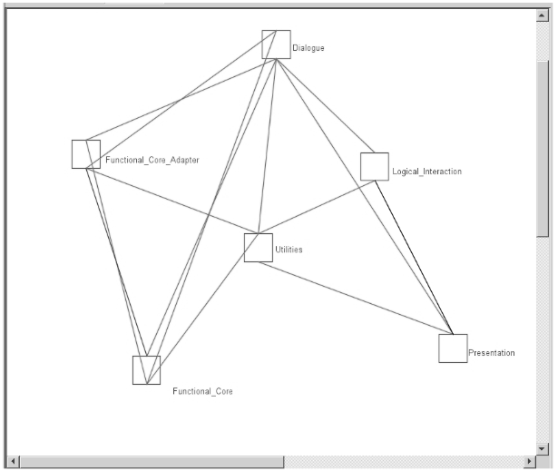
Case study: ‘Vanish’ System
Architecture view after aggregation of components
One can take help of the technical team to get a broad understanding of the system, before starting the aggregation exercise
March 2, 2024
SEZG651/SSZG653 Software Architectures

Slide 10
Case study: ‘Vanish’ System
Analyse architecture
One can notice that the architecture of ‘Vanish’ is not strictly layered
March 2, 2024
SEZG651/SSZG653 Software Architectures

Slide 11
Tools
Dali, ARMIN, Lattix, Sonar J, Structure 101
References:
https://resources.sei.cmu.edu/asset_files/TechnicalReport/2003_005_001_14081.pdf
March 2, 2024
SEZG651/SSZG653 Software Architectures

Slide 12
Experience sharing
Were you involved in architecture reconstruction of an existing system?
How did you go about it?
What tools did you use?
March 2, 2024
SEZG651/SSZG653 Software Architectures

Slide 13
Appendix
March 2, 2024
SEZG651/SSZG653 Software Architectures

Slide 14
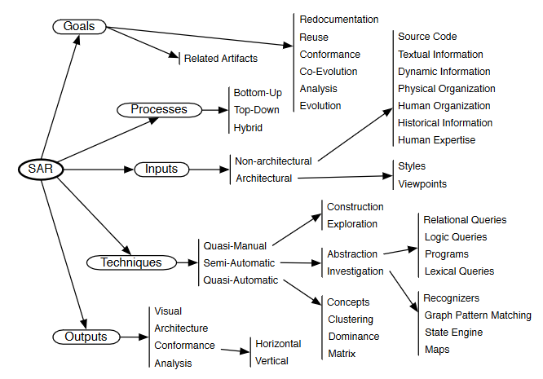
SAR: Sw Arch Reconstruction
Ref: https://rmod.inria.fr/archives/papers/Duca09c-TSE-SOAArchitectureExtraction.pdf
March 2, 2024
SEZG651/SSZG653 Software Architectures

Slide 15
Phases of architecture reconstruction
Raw view extraction gets information from source code, execution traces and build scripts. It gets info such as classes, file / data they use, caller – callee relationship, global data accessed by different objects
DB construction: Putting extracted data into a common format
View fusion: Combines views of info stored in DB. Source code analysis gives a static view. If some objects are dynamically bound at run time then execution trace will provide this information. Then an expert may group the elements into a layer
Arch analysis: Validate the correctness of architecture elements obtained from view fusion phase. Ex. There could be restriction that a layer calls objects in adjacent layers only. Or all db access should be via an entity bean only
Iterate
March 2, 2024
SEZG651/SSZG653 Software Architectures

Slide 16
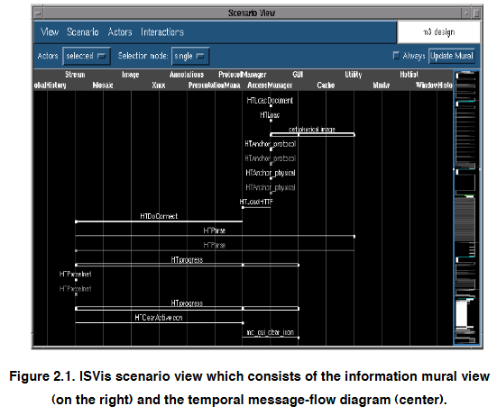
March 2, 2024
SEZG651/SSZG653 Software Architectures

Slide 17
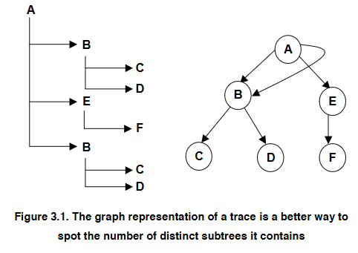
Ref: Techniques to Simplify the Analysis of Execution Traces for Program Comprehension by Abdelwahab Hamou-Lhadj
https://pdfs.semanticscholar.org/3db0/dd1980586c0a9d489e4b94c2996f117df2d5.pdf
March 2, 2024
SEZG651/SSZG653 Software Architectures

Slide 18

SonarCube Explores All Execution Paths
Issues
https://www.sonarqube.org/features/issues-tracking/
March 2, 2024
SEZG651/SSZG653 Software Architectures

Slide 19
Group extracted components
Combines views of info stored in DB.
View 1: Source code analysis gives a static view.
View 2: If some objects are dynamically bound at run time then execution trace will provide this information.
View 3: Then an expert may group the elements into a layer
Combine all these views to form a consolidated view
March 2, 2024
SEZG651/SSZG653 Software Architectures

Slide 20
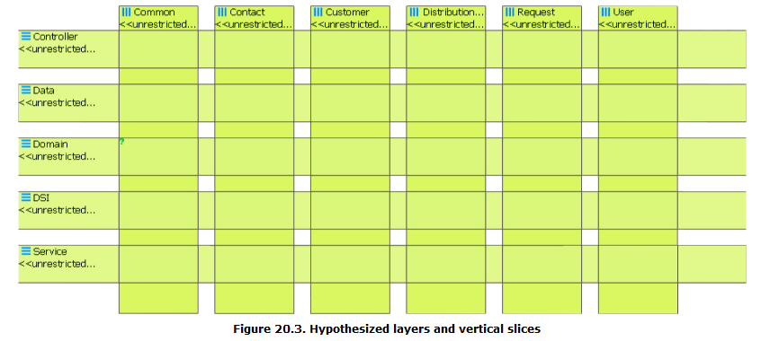
Sample View fusion using Sonar tool
Sonar tool allows definition of layers and vertical slices through the layers
The tool will populate the layers & slices with components / elements
March 2, 2024
SEZG651/SSZG653 Software Architectures

Slide 21
Architecture analysis
Check conformance to architecture
Ex. There could be restriction that a layer calls objects in adjacent layers only. Or
Ex. All db access should be via an entity bean only
March 2, 2024
SEZG651/SSZG653 Software Architectures

Slide 22
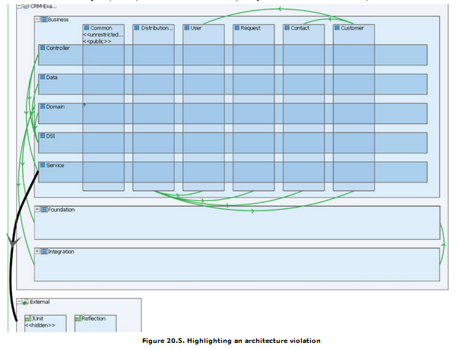
Example of violation of architecture (detected by Sonar)
No portion of the application should depend upon Junit. Based on this specification, Sonar detects the rule violation
March 2, 2024
SEZG651/SSZG653 Software Architectures

Slide 23
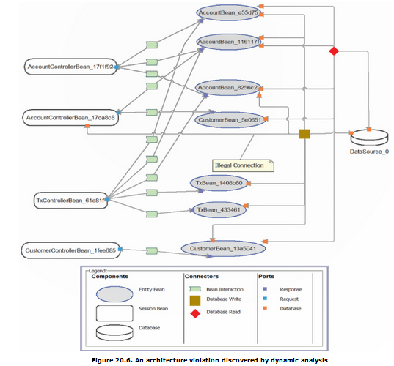
Example of architecture violation (detected by Sonar)
All database access is supposed to be managed by entity beans. Discovered by tool Disco Tect
March 2, 2024
SEZG651/SSZG653 Software Architectures

